Slide 1
Practical Bioinformatics for Biologist
2018
A small program to screen for haplotypes of transformer sequences
Fangying Chen
Pina Brinker
2/02/18
﻿https://github.com/pbrinker/Match-tra-haplotypes

Slide 2

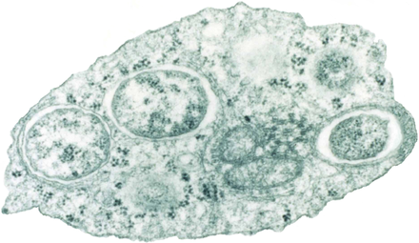
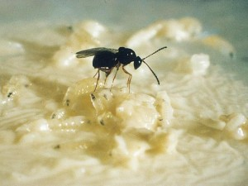
Why are we in the haplotype interested
uninfected
infected
Who survives?

Slide 3
Why are we in the haplotype interested
uninfected
infected
Who survives?
Based on screening by hand:
infected individuals show a different haplotype
It is the same on different locations and individuals

Slide 4
Workplan:
Step 1: prepare sequences
Align sequences
Trim sequences
Compare sequences for similarity
Step 2: Define haplotypes
Input sequence
Output if found as a haplotype yes or not
Step 3: Create haplotype dictionary

Slide 5
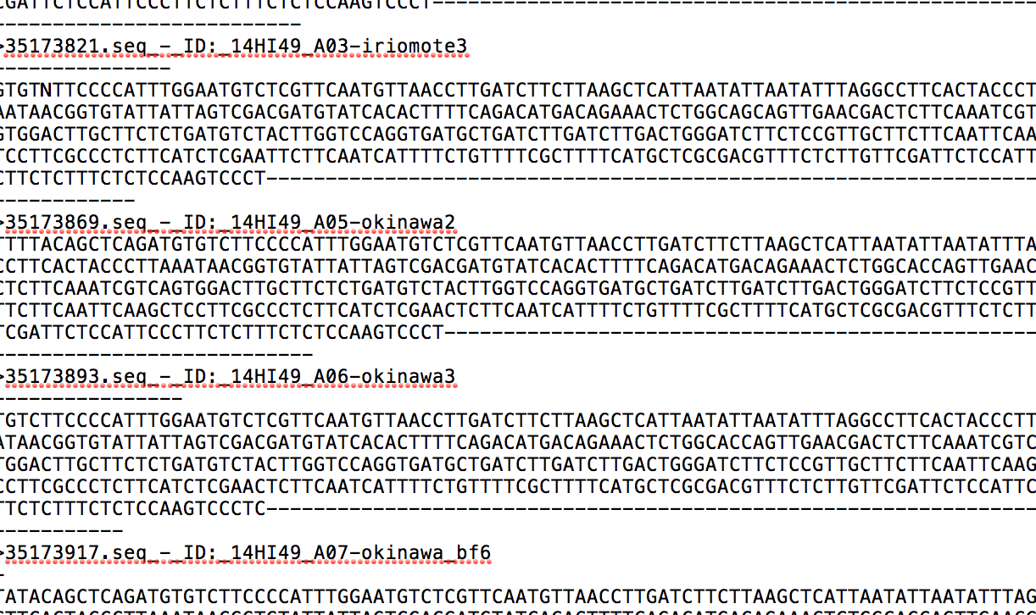
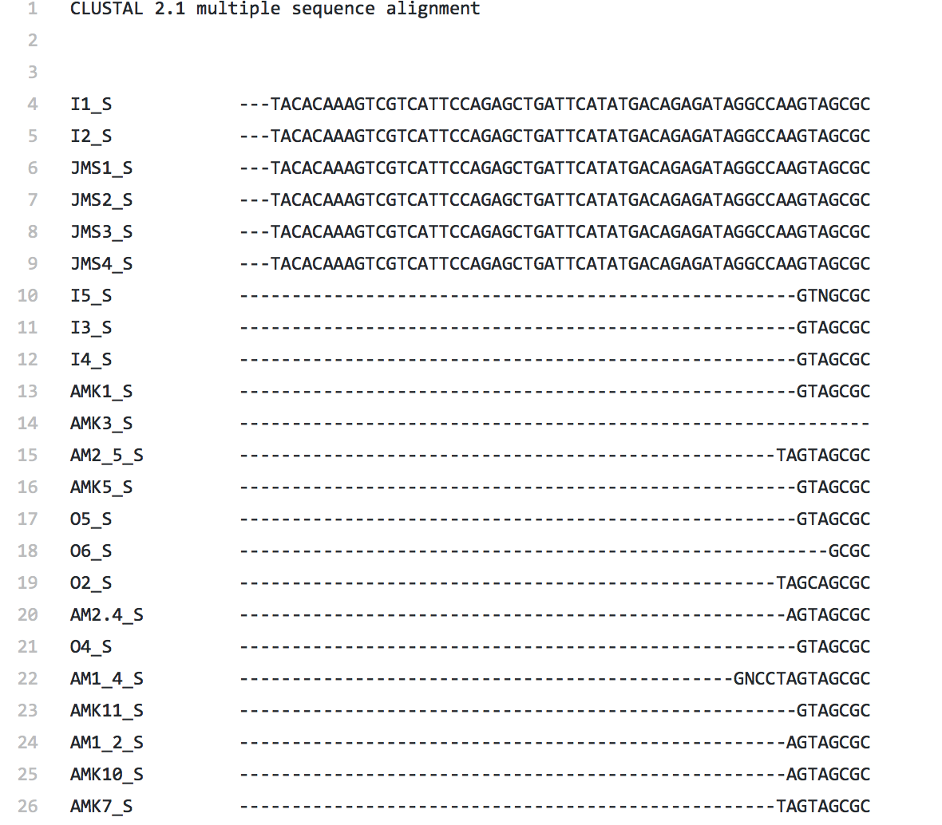
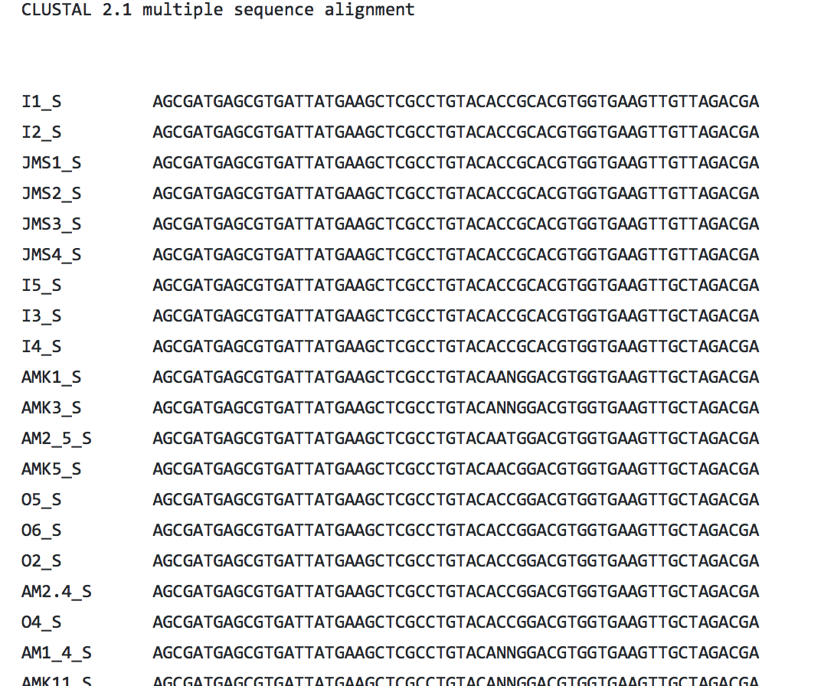
Step 1: Prepare sequences
Python: Create Alignment with the Bio.Align.Applications package
Shell: Trim the sequence
With trimAl

Slide 6
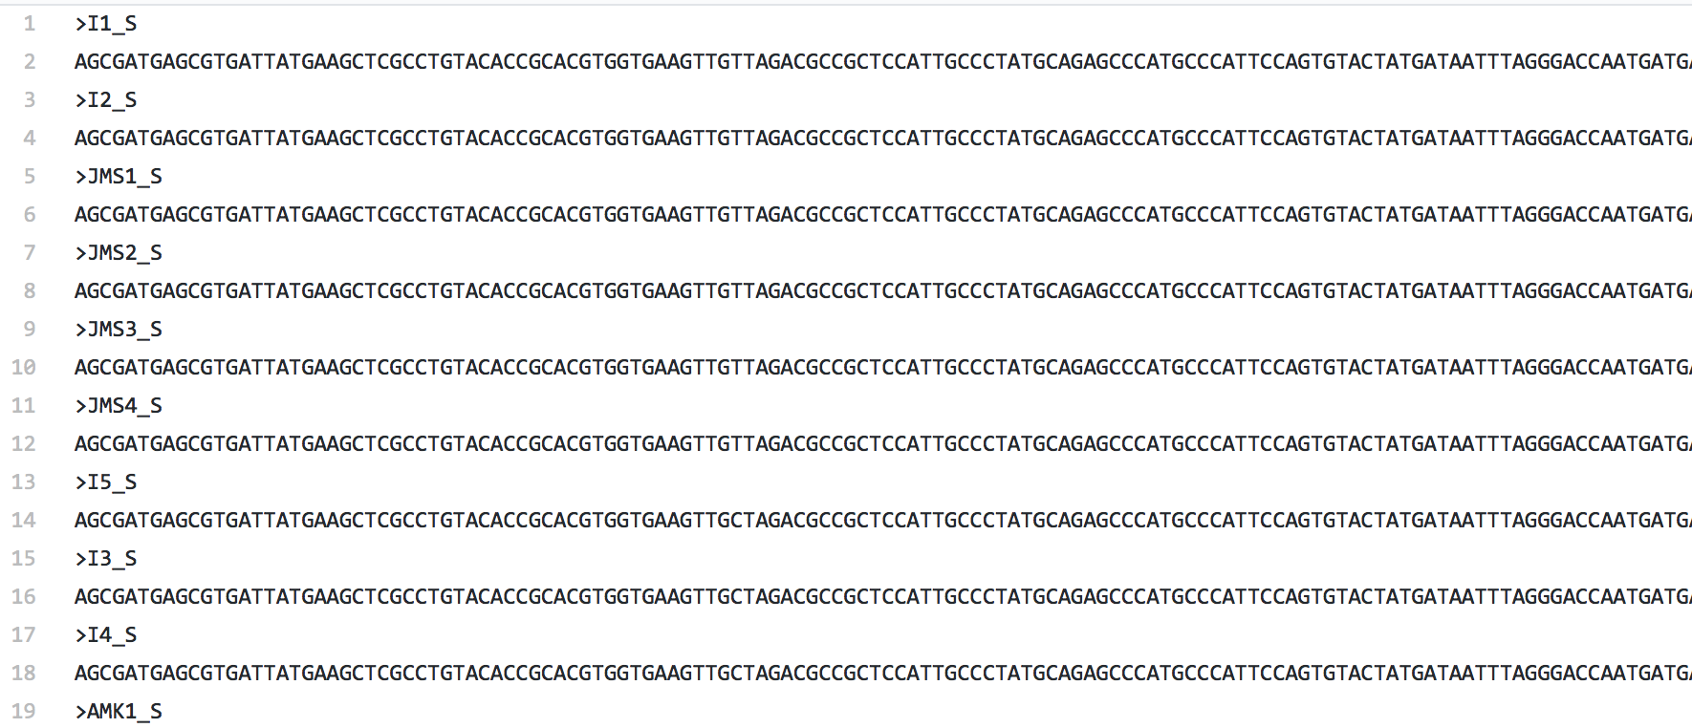
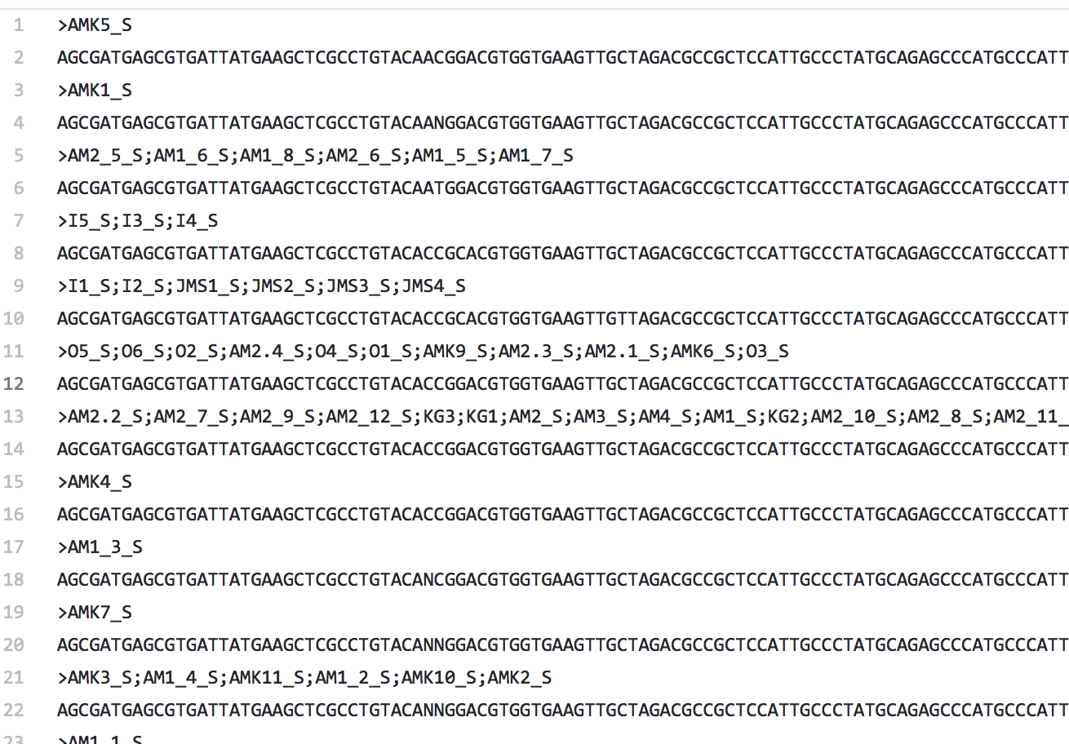
Step 2: Determine Haplotypes
Converted clustal format to fasta format
To determine haplotypes
-we grouped samples with a script using groupby from itertools after identical sequences
Haplotype list

Slide 7
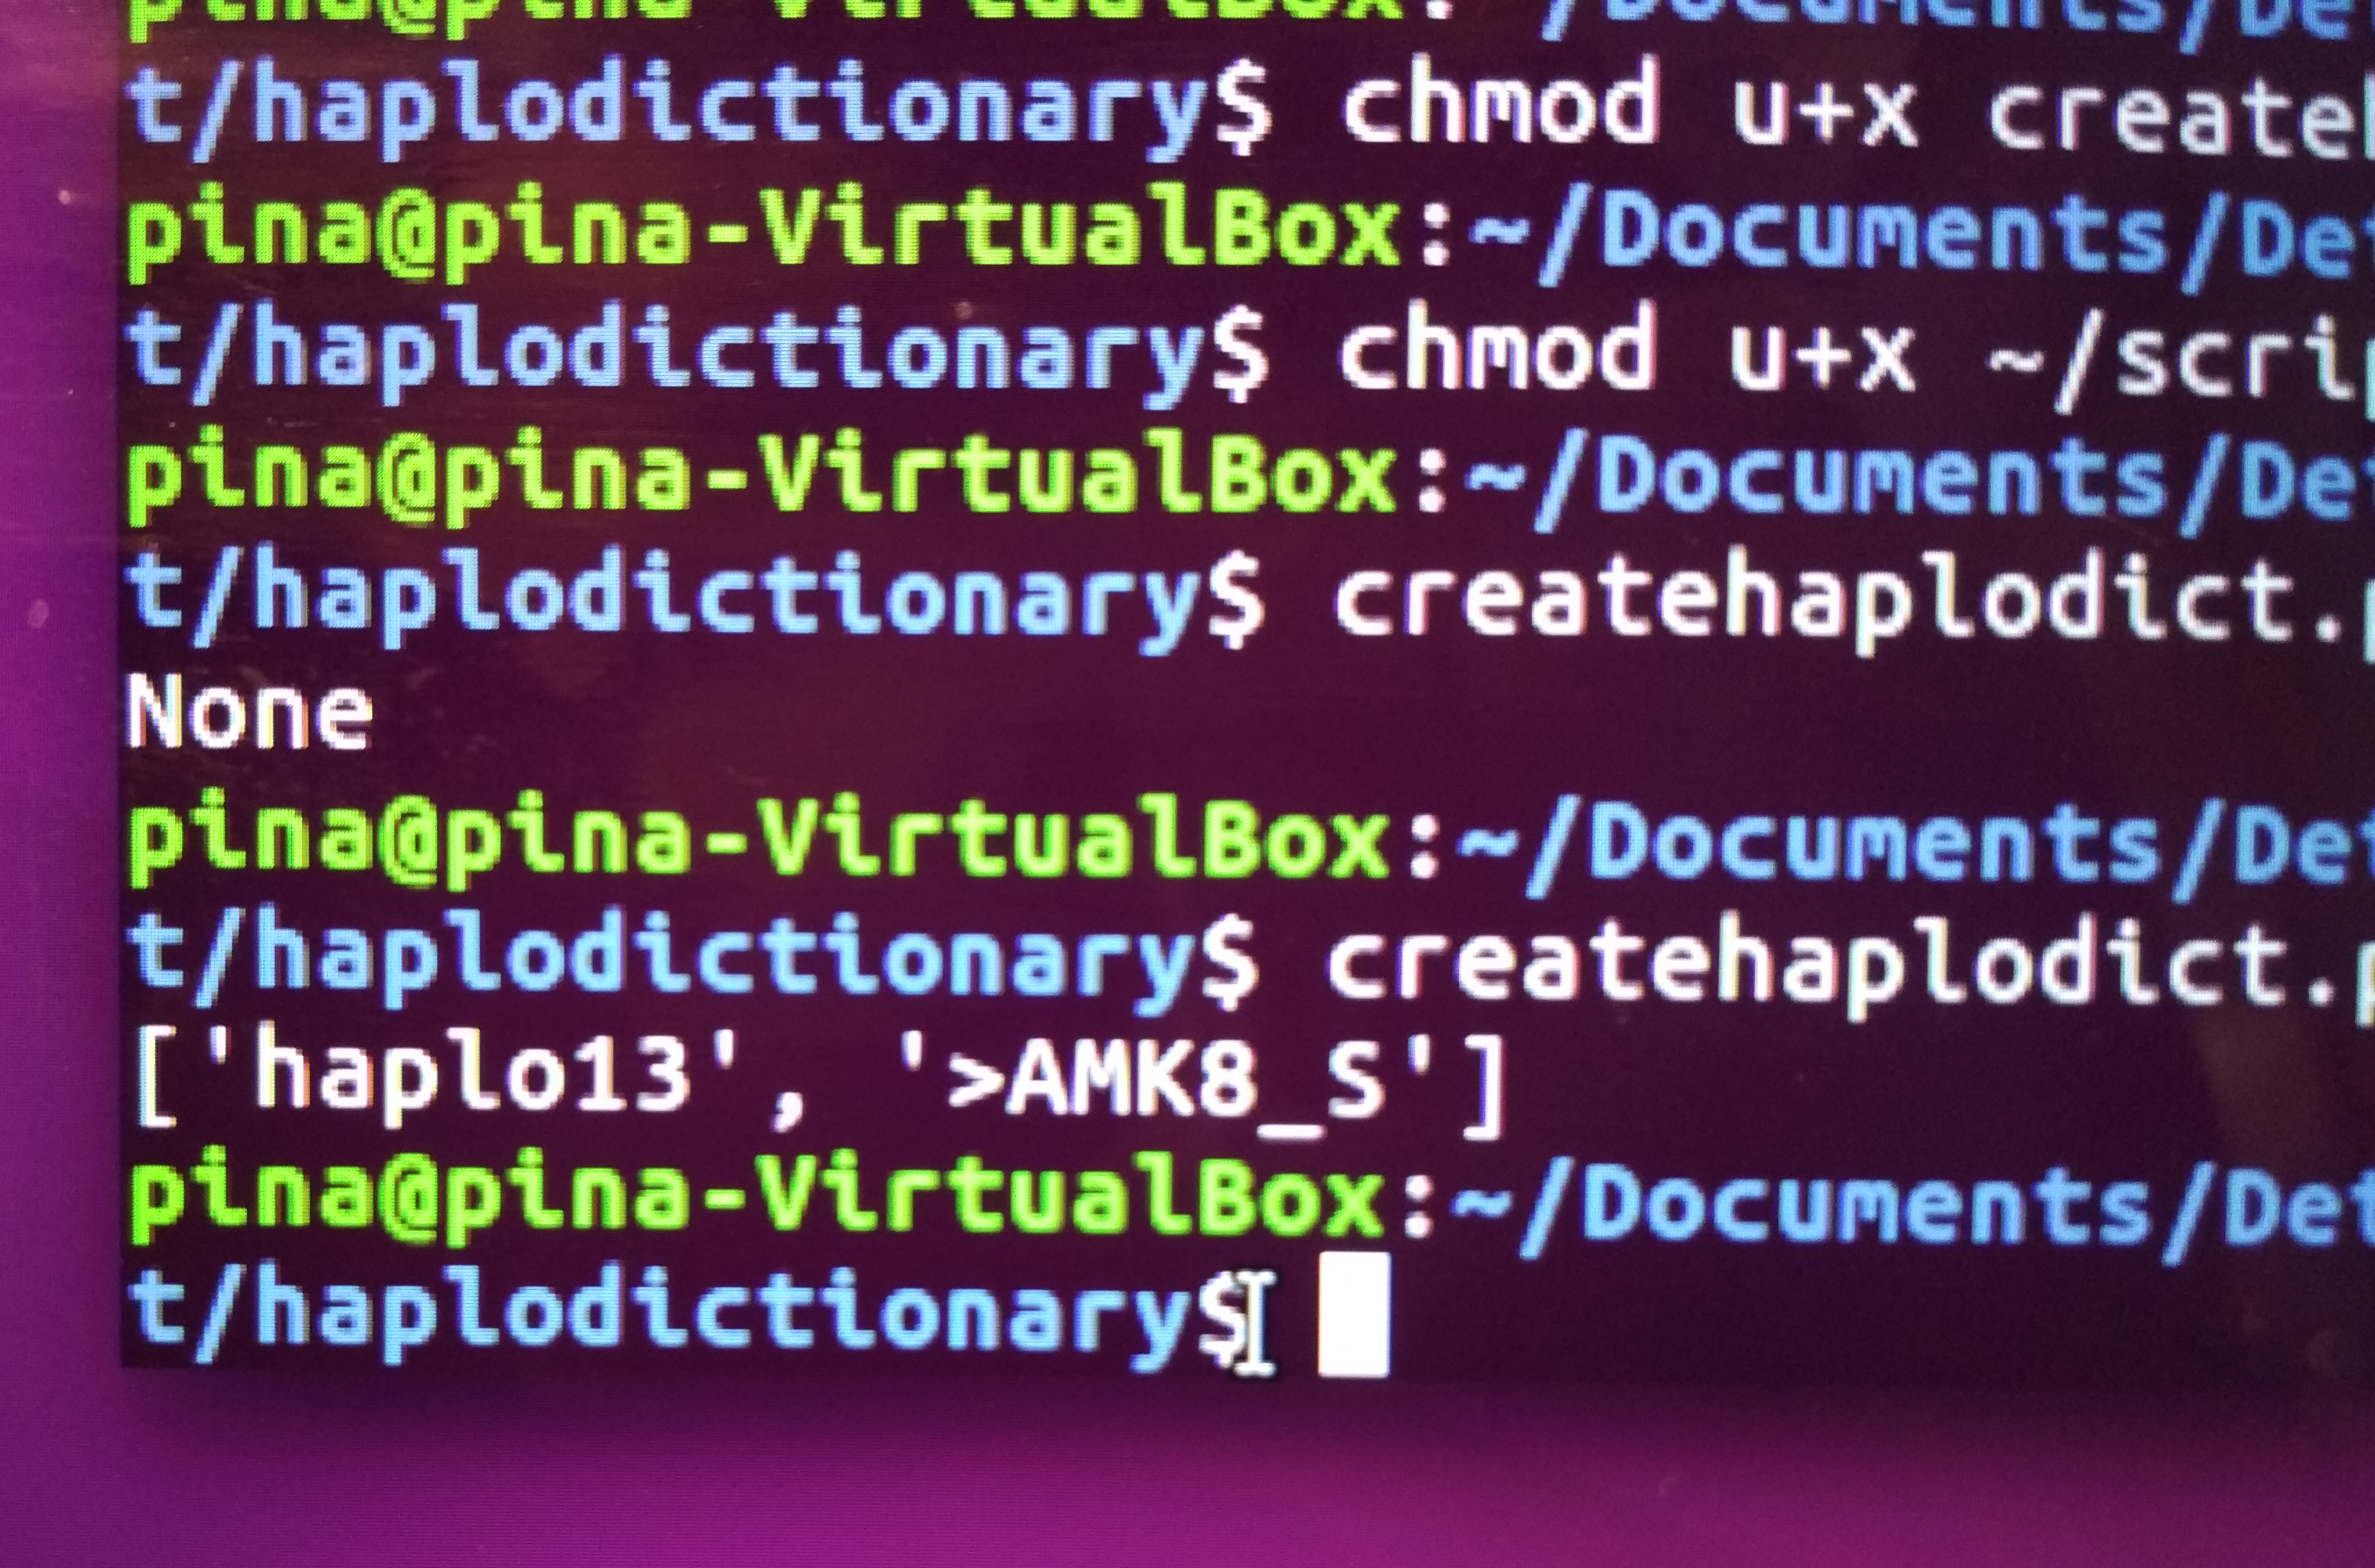
Step 3: Creating haplotype dictionary
Create a file,
space separated of the haplotype list
with sequences as key, and given Haplotype number and sample ID as value
GOAL:
Haplotype dictionary in which you can match sequences

Slide 8
Tool for matching sequences
Prepare sequence
Create dictionary
Test for match

Slide 9
Any Questions?

